Slide 1
Travel Itinerary
Mandy is an executive at Retail Extravaganza Incorporated, a company that pays door to door salespersons to sell clothing. She is visiting the WA branch offices to showcase the new season catalogue. Mandy wants to visit every WA branch office once over the next 2 weeks, spending at least 4 hrs at each office (which are not open on Saturdays or Sundays).
The company has offices in Perth, Esperance, Bunbury, Geraldton, Kalgoorlie, Karratha, Broome and Carnarvon. As Mandy has flown in from interstate, she needs to start and finish in Perth.
Mandy wants to fly from city to city for the northern cities but wants to drive around the south of the state and doesn’t want to travel late at night.
Each night she stops in a city, it costs $250 in accommodation
The cost of travelling by car is $75 per day (car rental) and 7c each kilometre for fuel.
Assume cars can travel at an average of 100km/hr and airplanes can travel at an average of 350km/hr (this will allow extra time for embarking, sorting luggage and checking in etc).
If she flies to each city, she will need an additional $50 per city for a taxi or Uber fares while in the city
1. Work out the route for her to travel.
2. Find the cost of flying your chosen route.
3. Calculate the distance she will drive.
4. Calculate the time it will take to drive and the cost of petrol for the driven part of her journey.
5. Create the schedule for the driven part of her journey and from that calculate the total cost of driving (including accommodation).
6. What is the cost of all the flights she will take?
8. Use the scale to calculate the distances of the flights and therefore the travel times.
9. Create a schedule for her to follow to visit all the cities (she can travel on Saturdays and Sundays but cannot visit a Branch office on a weekend)?.
7. Will 2 weeks be enough time for her to visit each branch office?
Draw a table to show the daily schedule she will need to keep.

Slide 2
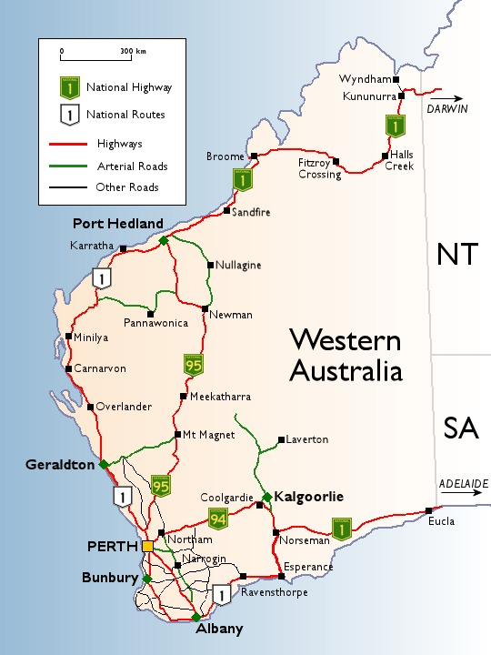
Cost of Flights
Perth to Broome | 450 |  | Carnarvon to Broome | 350 |  | Geraldton to Broome | 450 |  | Bunbury to Broome | NA
Perth to Karratha | 920 |  | Carnarvon to Karratha | 290 |  | Geraldton to Karratha | 420 |  | Bunbury to Karratha | NA
Perth to Geraldton | 280 |  | Carnarvon to Geraldton | 290 |  | Geraldton to Carnarvon | 250 |  | Bunbury to Carnarvon | NA
Perth to Carnarvon | 390 |  | Carnarvon to Perth | 270 |  | Geraldton to Perth | 290 |  | Bunbury to Perth | 290
Perth to Esperance | 410 |  | Carnarvon to Esperance | NA |  | Geraldton to Esperance | NA |  | Bunbury to Esperance | 290
Perth to Bunbury | 260 |  | Carnarvon to Bunbury | NA |  | Geraldton to Bunbury | NA |  | Bunbury to Geraldton | NA
Perth to Kalgoorlie | 410 |  | Carnarvon to Kalgoorlie | 550 |  | Geraldton to Kalgoorlie | 430 |  | Bunbury to Kalgoorlie | 330
Broome to Karratha | 480 |  | Karratha to Broome | 380 |  | Esperance to Broome | NA |  | Kalgoorlie to Broome | 890
Broome to Carnarvon | 560 |  | Karratha to Carnarvon | 310 |  | Esperance to Karratha | NA |  | Kalgoorlie to Karratha | 880
Broome to Geraldton | 610 |  | Karratha to Geraldton | NA |  | Esperance to Geraldton | NA |  | Kalgoorlie to Carnarvon | 650
Broome to Perth | 510 |  | Karratha to Perth | 890 |  | Esperance to Perth | 440 |  | Kalgoorlie to Perth | 450
Broome to Bunbury | NA |  | Karratha to Esperance | NA |  | Esperance to Carnarvon | NA |  | Kalgoorlie to Esperance | 360
Broome to Esperance | NA |  | Karratha to Bunbury | NA |  | Esperance to Bunbury | 420 |  | Kalgoorlie to Bunbury | 390
Broome to Kalgoorlie | 910 |  | Karratha to Kalgoorlie | 950 |  | Esperance to Kalgoorlie | 310 |  | Kalgoorlie to Geraldton | 490

